Slide 1


Computer
Lecture 4
Dr. Nada Abdullah Rasheed
Assist prof. / Computer Science

Slide 2
Syllabus Content
Subject | Lec. No.
Computers Components - Introduction | 3
Computer Basic Operations | 4
Input Unit | 5

Slide 3
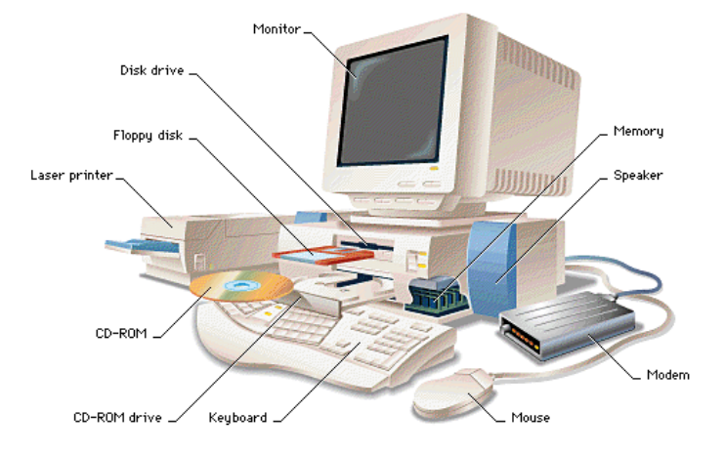
Computer Components
3.1 Introduction
In this Chapter we present all types of computers follow the same basic logical structure and perform the following five basic operations for converting raw input data into information useful to their users.

Slide 4
Computer Basic Operations
•Input
•Output
•Process
•Storage
•Control

Slide 5
Input Unit
This unit contains devices with the help of which we enter data into the computer. This unit creates a link between the user and the computer. The input devices translate the information into a form understandable by the computer.
Following are some of the important input devices which are used in a computer: Keyboard Mouse Joy Stick Light pen Track Ball Scanner Graphic Tablet Microphone Magnetic Ink Card Reader (MICR) Optical Character Reader (OCR) Bar Code Reader Optical Mark Reader (OMR).

Slide 6
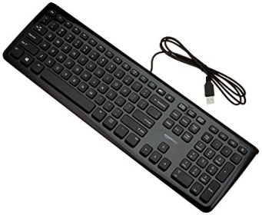
Keyboard
The keyboard is the most common and very popular input device which helps to input data to the computer. The layout of the keyboard is like that of traditional typewriter, although there are some additional keys provided for performing additional functions.

Slide 7
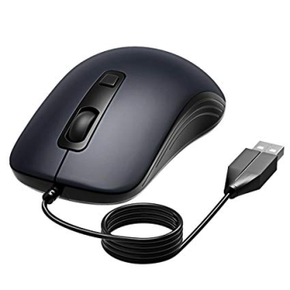
Mouse
The mouse is the most popular pointing device. It is a very famous cursor-control device having a small palm size box with a round ball at its base, which senses the movement of the mouse and sends corresponding signals to the CPU when the mouse buttons are pressed. Generally, it has two buttons called the left and the right button and a wheel is present between the buttons. A mouse can be used to control the position of the cursor on the screen, but it cannot be used to enter text into the computer.
Advantages
Easy to use
Not very expensive
Moves the cursor faster than the arrow keys of the keyboard

Slide 8
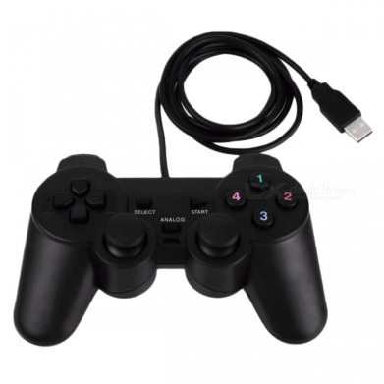
Joystick
Joystick is also a pointing device, which is used to move the cursor position on a monitor screen. It is a stick having a spherical ball at its both lower and upper ends. The lower spherical ball moves in a socket.
The joystick can be moved in all four directions.
The function of the joystick is similar to that of a mouse. It is mainly used in Computer Aided Design (CAD) and playing computer games.

Slide 9
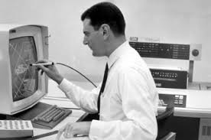
Light Pen
Light pen is a pointing device similar to a pen. It is used to select a displayed menu item or draw pictures on the monitor screen. It consists of a photocell and an optical system placed in a small tube.
When the tip of a light pen is moved over the monitor screen and the pen button is pressed, its photocell sensing element detects the screen location and sends the corresponding signal to the CPU.

Slide 10
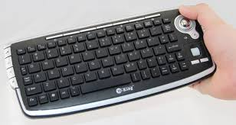
Track Ball
The track ball is an input device that is mostly used in notebook or laptop computer, instead of a mouse. This is a ball which is half inserted and by moving fingers on the ball, the pointer can be moved.
Since the whole device is not moved, a track ball requires less space than a mouse. A track ball comes in various shapes like a ball, a button, or a square.

Slide 11
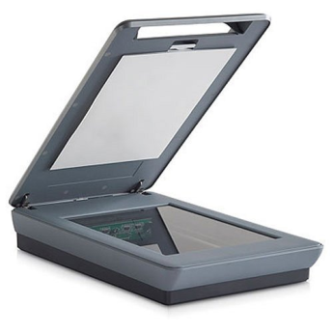
Scanner
The scanner is an input device, which works more like a photocopy machine.
It is used when some information is available on paper and it is to be transferred to the hard disk of the computer for further manipulation.
The scanner captures images from the source which are then converted into a digital form that can be stored on the disk. These images can be edited before they are printed.

Slide 12
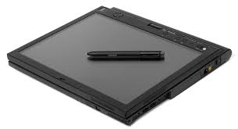
Digitizer
Digitizer is an input device which converts analog information into digital form. The digitizer can convert a signal from the television or camera into a series of numbers that could be stored in a computer. They can be used by the computer to create a picture of whatever the camera had been pointed at. Digitizing is also known as Tablet or Graphics Tablet as it converts graphics and pictorial data into binary inputs. A graphic tablet as digitizer is used for fine works of drawing and image manipulation applications.

Slide 13
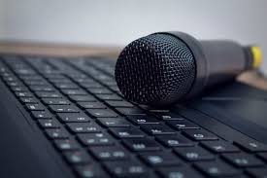
Microphone
The microphone is an input device to input sound that is then stored in a digital form. The microphone is used for various applications such as adding sound to a multimedia presentation or for mixing music.

